Slide 1
File system, VFS and Virtualization

Slide 2
A simple description of the UNIX system, also applicable to Linux, is this:
"On a UNIX system, everything is a file; if something is not a file, it is a process.“
A file system is an organization of data and metadata on a storage device

Slide 3
The file system must keep track of which blocks belong to which files.
which blocks belong to which files.
In what order the blocks form the file.
which blocks are free for allocation.

Slide 4
A Possible File System Layout
Superblock contains info about the fs (number of blocks in the partition, size of the blocks, free block count and free-block pointers etc)
i-nodes contain info about files
Tanenbaum, Modern Operating Systems 3 e, (c) 2008 Prentice-Hall, Inc. All rights reserved. 0-13-6006639

Slide 5
File System
A file system is consists of a sequence of logical blocks (512/1024 byte etc.)
A file system has the following structure:
Boot Block | Super Block | Inode List | Data Blocks

Slide 6
Partitions and Mounting
Associating a file system to a storage device in Linux is a process called mounting
During a mount, you provide a file system type, a file system
The mount command is used to attach a file system to the current file system hierarchy (root). mount point.

Slide 7
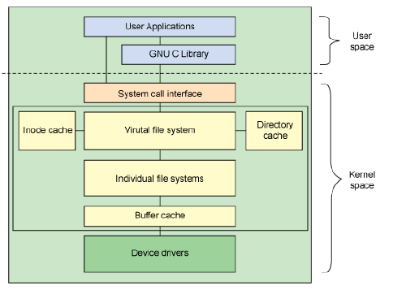
Architectural view of Linux file system components

Slide 8
The VFS is the primary interface to the underlying file systems. This component exports a set of interfaces and then abstracts them to the individual file systems, which may behave very differently from one another

Slide 9
Linux file system:Cross-development
Linux: first developed on a minix system
Both OSs shared space on the same disk
So Linux reimplemented minix file system
Two severe limitations in the minix FS
Block addresses are 16-bits (64MB limit)
Directories use fixed-size entries (w/filename)

Slide 10
Extended File System
Originally written by Chris Provenzano
Extensively rewritten by Linux Torvalds
Initially released in 1992
Removed the two big limitations in minix
Used 32-bit file-pointers (filesizes to 2GB)
Allowed long filenames (up to 255 chars)
Question: How to integrate ext into Linux?

Slide 11
Xia and Ext2 filesystems
Two new filesystems introduced in 1993
Both tried to overcome Ext’s limitations
Xia was based on existing minix code
Ext2 was based on Torvalds’ Ext code
Xia was initially more stable (smaller)
But flaws in Ext2 were eventually fixed
Ext2 soon became a ‘de facto’ standard

Slide 12
VFS
What is it ?
VFS is a kernel software layer that handles all system calls related to file systems. Its main strength is providing a common interface to several kinds of file systems.

Slide 13
The Virtual File System idea
Multiple file systems need to coexist
But file systems share a core of common concepts and high-level operations
So can create a file system abstraction ?
Applications interact with this VFS
Kernel translates abstract-to-actual

Slide 14
Task 1
Task 2
…
Task n
user space
kernel space
VIRTUAL FILE SYSTEM
minix
ext2
msdos
proc
Buffer Cache
device driver
for hard disk
device driver
for floppy disk
Linux Kernel
software
hardware
Hard Disk
Floppy Disk

Slide 15
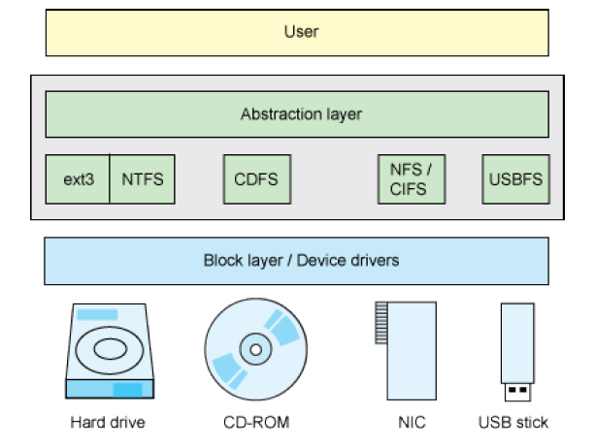
VFS provides a uniform interface

Slide 16
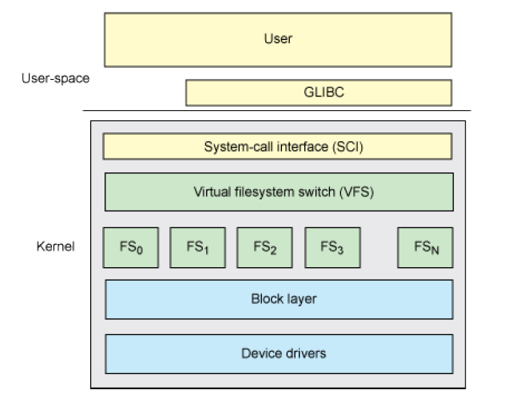
Layered archi of vfs

Slide 17
Filesystem performance
Two predominant performance criteria:
Speed of access to file’s contents
Efficiency of disk storage utilization
How can these be meaningfully measured

Slide 18
Free-Space Management
Since disk space is limited, we need to reuse the space from deleted files for new files, if possible.
To keep track of free disk space, the system maintains a free-space list. The free-space list records all free disk blocks.
To create a file, we search the free-space list for the required amount of space and allocate that space to the new file.
When a file is deleted, its disk space is added to the free-space list.

Slide 19
Free space list implementation
Bit Vector
Linked List
Grouping
Counting

Slide 20
Bit vector
Frequently, the free-space list is implemented as a bit map or bit vector.
Each block is represented by 1 bit. If the block is free, the bit is 1; If the block is allocated, the bit is O.
For example, consider a disk where blocks 2, 3, 4, 5, 8, 9, 10, 11, 12, 13, 17, 18,25,26, and 27 are free and the rest of the blocks are allocated.
001111001111110001100000011100000 ...

Slide 21
Unfortunately, bit vectors are inefficient unless the entire vector is kept in main memory (and is written to disk occasionally for recovery needs).
Keeping it in main memory is possible for smaller disks but not necessarily for larger ones.
A 500-GB disk with a 1-KB block and a 32-bit (4 bytes) disk block number, we need 488 million bits for the map, which requires just under 60000 1-KB blocks to store ( ).

Slide 22
Linked list
Another approach to free-space management is to link together all the free disk blocks, keeping a pointer to the first free block in a special location on the disk and caching it in memory.
This first block contains a pointer to the next free disk block, and so on.

Slide 23
Grouping
A modification of the free-list approach is to store the addresses of n free blocks in the first free block.
The first of n-1 these blocks are actually free. The last block contains the addresses of another n free blocks, and so on.
The addresses of a large number of free blocks can now be found quickly, unlike the situation when the standard linked-list approach is used.

Slide 24
Counting
Another approach is to take advantage of the fact that, generally, several contiguous blocks may be allocated or freed simultaneously, particularly when space is allocated with the contiguous-allocation algorithm or through clustering.
Thus, rather than keeping a list of free disk addresses, we can keep the address of the first free block and the number of free contiguous blocks that follow the first block.
Each entry in the free-space list then consists of a disk address and a count.

Slide 25
Virtualization

Slide 26
Virtualization is a technique of dividing the Resources of Computer into multiple execution environments.
Virtualization can run multiple Operating System on Single Hardware.

Slide 27
Advantages
Consolidate the workloads of several under-utilized servers to fewer machines.
Provide secure, isolated sandboxes for running untrusted applications.
Operating systems or Execution environments with Resource limits and Resource guarantees.
Running Multiple operating systems simultaneously: different versions.

Slide 28
advantages
Encapsulate the entire state of a running system: you can save the state, examine it, modify it, reload it, and so on.
Virtualization can make tasks such as system migration, backup, and recovery easier and more manageable.

Slide 29
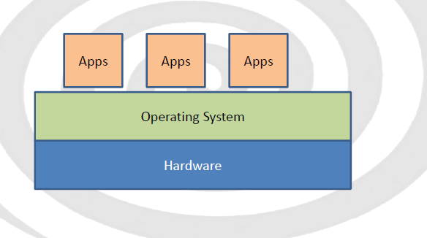
Modern computer system

Slide 30
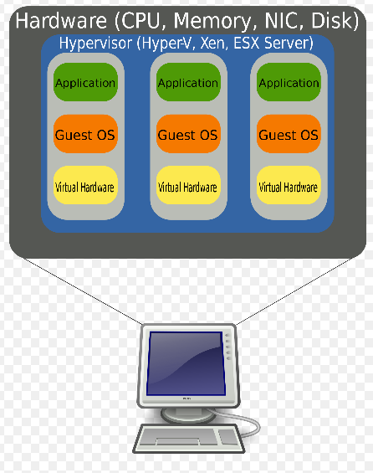

Slide 31
Hypervisor
A layer between Virtual machine and hardware
It hides the physical characteristics of a computing platform from users, instead showing another abstract computing platform
At its origins, the software that control virtualization is called a "control program", but the terms "hypervisor" or "virtual machine monitor are now preferred.

Slide 32
The hypervisor presents the guest operating systems with a virtual operating platform and manages the execution of the guest operating systems.
Multiple instances of a variety of operating systems may share the virtualized hardware resources.

Slide 33
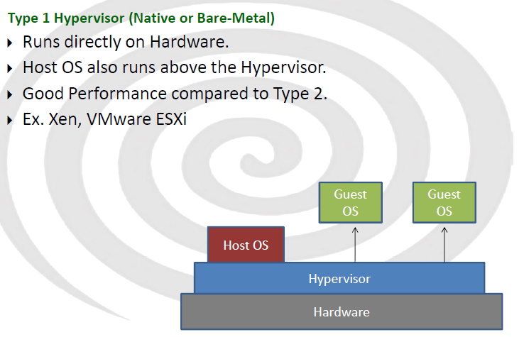
Hyper visor types

Slide 34
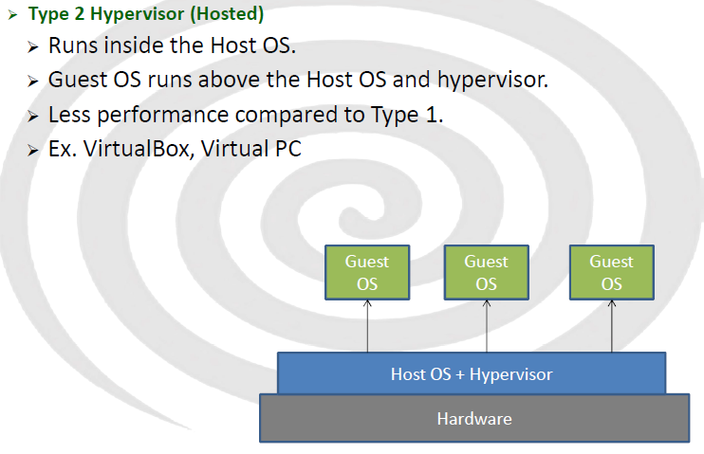

Slide 35
Commercial products
VMware ESX Server and VMWare Server
Sun xVM
Oracle VM
Citrix XenServer
Parallels Virtuozzo Containers
Open Source
Xen
KVM
Virtual Box Open Source Edition
Linux –Vserver
Bochs

Slide 36
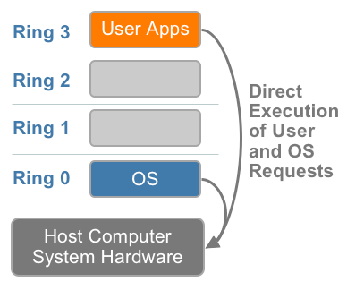
x86 privilege level architecture without virtualization

Slide 37
Virtualizing the x86 architecture
Virtualizing the x86 architecture requires placing a virtualization layer under the operating system (which expects to be in the most privileged Ring 0) to create and manage the virtual machines that deliver shared resources.
Further complicating the situation, some sensitive instructions can’t effectively be virtualized as they have different semantics when they are not executed in Ring 0.

Slide 38
Three alternative techniques now exist for handling sensitive and privileged instructions to virtualizes the CPU on the x86 architecture:
Full virtualization using binary translation
OS assisted virtualization or paravirtualization
Hardware assisted virtualization (first generation)

Slide 39
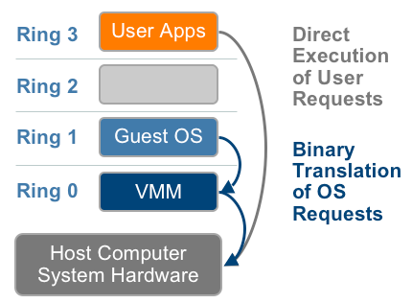
Full virtualization

Slide 40
This approach, depicted in Figure translates kernel code to replace non-virtualizable instructions with new sequences of instructions that have the intended effect on the virtual hardware.
Uses Binary translation technique.
– Modification of Guest is not required.
– Tough to Implement.
– Easy to use.
– Performance Less than Para Virtualization.
– All types of OS can be used as Virtual Machines.
– VMware, Microsoft, Parallels use Full Virtualization

Slide 41
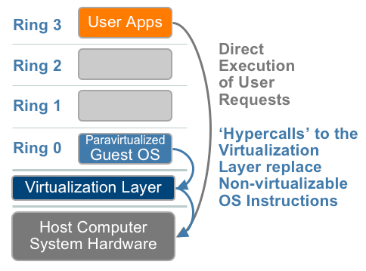
Para virtualization

Slide 42
Para-virtualization, as shown in Figure 6, involves modifying the OS kernel to replace non-virtualizable instructions with hyper calls that communicate directly with the virtualization layer hypervisor.
The hypervisor also provides hyper call interfaces for other critical kernel operations such as memory management
– Guest OS drivers are optimized to work with Hypervisor.
– Modification of Guest OS is required.
– Performance is little more than Full Virtualization.
– Open Source OS like Linux can only be used.
– Proprietary OS like Windows cannot be Para Virtualized.
– Xen uses Para Virtualization on x86

Slide 43
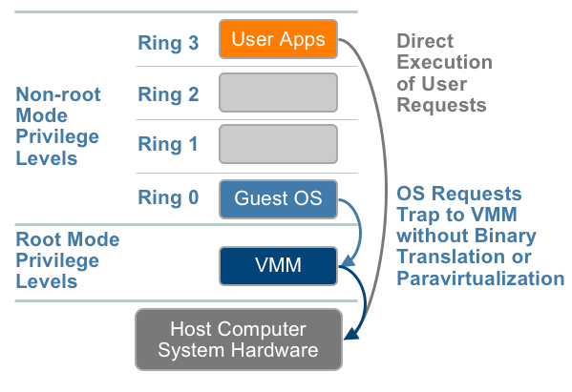
Hardware assisted virtualization

Slide 44
Hardware assisted virtualization
– Latest.
– Hardware itself has Virtualized Instruction set
– Implemented by Intel-VT (Virtualization Technology) and
– AMD-V(Virtualization) processors.
– Provides Root mode and Non-root mode.
– Hypervisor runs directly on Hardware using Root mode.
– Easy to implement.
– No need of Binary Translation or HyperCalls.
– Used by Xen ,VMware, Microsoft etc.

Slide 45
Criticism
Single point of Failure.
Demands Powerful Machines.
Performance ?
Misbehaviour of application like Databases,High Graphics app like Video Games.
New layer of Complexity.
Software Licensing.
Skilled Administrators.
Standards present, but not Implemented

Slide 46
Linux kernel
File structure
How to add changes into the Linux kernel ?
Kernel compilation
Loadable kernel modules

Slide 47
Linux Kernel Compilation : Steps in compiling a kernel:
Installing the sources.
Configuring the kernel (choosing which features and Drivers to compile).
Compiling the kernel (i.e. typing a single command, and watching...).
Installing the compiled kernel.
Updating the boot loader to recognize the new kernel.
Booting...
Making the new kernel become the default.

Slide 48
Commands for the kernel compilation
rpm -Uvh /path/to/kernel-source-2.4.20-8.i386.rpm
cd /usr/src/
tar xjf /path/to/linux-2.4.24.tar.bz2
make menuconfig (configuring the kernel)
make depend
make bzImage ( compiling the kernel)
make modules
cp arch/i386/boot/bzImage /boot/vmlinuz-2.4.20-8
cp -rp /lib/modules/2.4.20-8 /lib/modules/2.4.20-8.old
make modules_install
mkinitrd /boot/initrd-2.4.20-8.img 2.4.20-8

Slide 49
Boot loader changes
Instructions for GRUB
title Red Hat Linux (2.4.20-8) root (hd0,0) kernel /boot/vmlinuz-2.4.20-8 ro root=/dev/hda1 hdc=ide-scsi initrd /boot/initrd-2.4.20-8.img

Slide 50
Loadable kernel module (LKM)
Modules are pieces of code that can be loaded and unloaded into the kernel upon demand. They extend the functionality of the kernel without the need to reboot the system.
http://tldp.org/HOWTO/Module-HOWTO/index.html

Slide 51
Linux kernel compilation
http://linuxtweaking.blogspot.in/2010/05/how-to-compile-kernel-on-ubuntu-1004.html
http://lxr.free-electrons.com/
http://www.haifux.org/lectures/88-sil/kernel-compilation.html

